Slide 1
Career Perspectives Panel
Neeraj Bharadwaj
Associate Professor of Marketing, University of Tennessee
Subin Im
Professor of Marketing, Yonsei University
Yazhen (Sophie) Xiao
Assistant Professor of Marketing, University of Tennessee
August 7, 2019 ⚬ 9:00 am – 10:30 am ⚬ Room: 2043

Slide 2
My Background: Yazhen (Sophie) Xiao
Education
Research Interests
Services
Consumer adoption of (new) products
Firm NPD strategy
Academic:
Ad-hoc journal reviewers
Doctoral dissertation committees
Publications:
JAMS, JPIM, JSR, JBE, JBR, IMM, IMR, RMR
Professional:
Chair of PDMA’s China Marketing & Exam Maintenance Sub-committee

Slide 3
My Background: Subin Im

Slide 4
Short Bio: Subin Im
Research Interests:
(Primary) Organizational aspects of innovation, creativity and innovation, new product development for marketing strategy,
(Secondary) Research methodology using multivariate statistical techniques and SEM.
Publications:
Journal of Marketing, Strategic Management Journal, Journal of the Academy of Marketing Science , Journal of Product Innovation Management(5), International Journal of Research in Marketing, Journal of International Marketing, and Journal of Business Research, and Psychological Reports among others.
Academic Services:
(Serving) Editorial Boards at JPIM and JBR, (Served) Editorial Boards at JAMS
Conference Track Chairs for PDMA, AMS, and AMA, Conference Co-chair for 2021’ Winter AMA
(Served) An Associate Dean of MBA Programs at Yonsei School of Business.
Professional Experience
A market researcher at the Hynix Semiconductor Inc. in Korea
An international banking officer at California banks

Slide 5
My Background: Neeraj Bharadwaj
Research Interest:
Understanding the financial performance implications of strategic (corporate-level) marketing decisions
Topics include: marketing & innovation representation in the C-suite; innovation in data-rich environments; evaluating structured and unstructured data to enhance sales pitch effectiveness; and branding & sustainability.
Publications:
Journal of Marketing, Journal of the Academy of Marketing Science, International Journal of Research in Marketing, Journal of Retailing, Journal of Product Innovation Management….
Academic Service:
Editorial Board Member at JAMS and JPIM; ad hoc reviewer at JM, IJRM, JR….
Guest Co-Editor, JPIM Special Issue “Innovation in Data-Rich Environments” (September 2017)
Chair and Organizer, “Marketing Strategy Meets Wall Street V” (August 2017)
Organizer, “Marketing Strategy Meets Wall Street VI” (June 2019)
Notes:
Dear, Neeraj, Subin & Sophie,
Here is a quick update about the 2019 PDMA Doctoral Consortium at the University of Illinois.
We are requesting that you participate in a panel titled, "Career Perspectives." Please see the attached schedule for more details regarding the day & time of this session. Please plan on speaking for between 15-20 minutes and then taking questions at the end of the session. The room is fully equipped with technology for showing PPT slides and videos. In addition, it has a large whiteboard in case you would like to do some old fashioned writing on the board.
Thanks again for your participation in this year's Consortium! If for some reason, this session doesn't work for you, please let us know.
We look forward to seeing you in August.
Best,
Many thanks for getting the ball rolling on this early. I’m on board with your proposal to spend time: 1) describing our respective career paths (perhaps 5-7 minutes each), and 2) sharing our respective do and not to do lists (perhaps 10 minutes each). Perhaps we can also reserve time for a Q&A session for the students.

Slide 6
Some Suggestions for Research
Do
Don’t
1. Have a clear research identity (BIG)
2. Prioritize based on importance to you and the field
3. Embrace a Janus-face
4. Fully grasp the literature to which you wish to contribute.

Slide 7
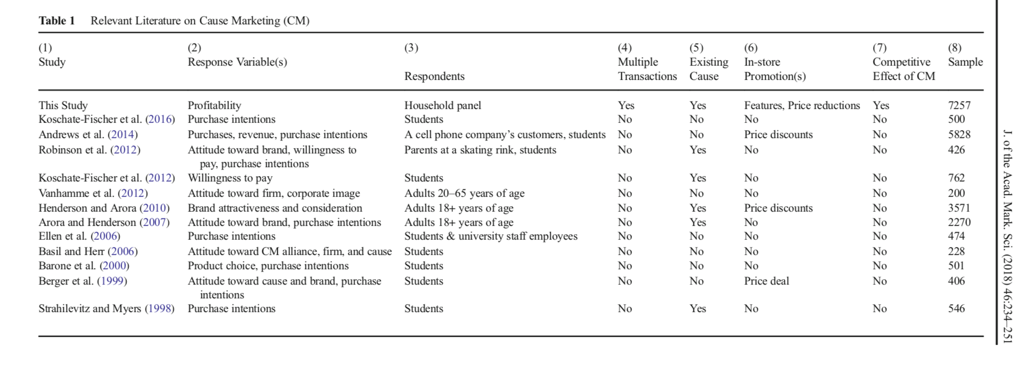
Michel Ballings, Heath McCullough, and Neeraj Bharadwaj

Slide 8
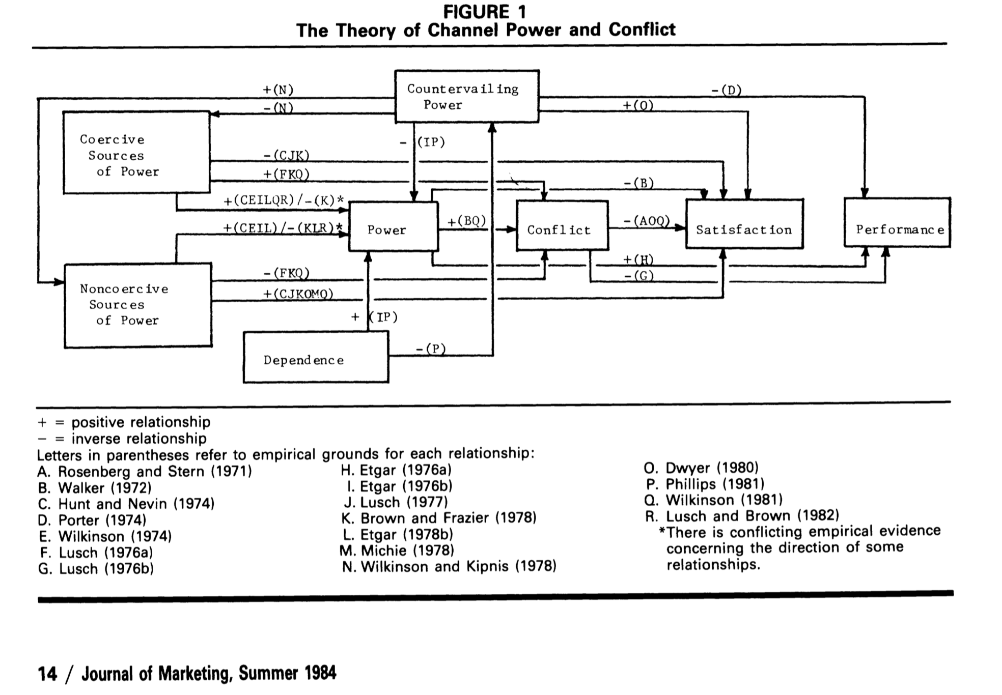
John Gaski

Slide 9
Some Suggestions for Research
Do
Don’t
1. Have a clear research identity (BIG)
2. Prioritize based on importance to you and the field
3. Embrace a Janus-face
4. Fully grasp the literature to which you wish to contribute.
1. Engage in inter-disciplinary research right away
2. Continue to hold on to pet projects that the market doesn’t want!
5. Have research project portfolio in all different stages of research from incubation to close to publication.
6. Network through conferences, seminars even thorough interviews
7. Must be good at least one thing (writing, research method, or connecting).
8. Serve for academic community as an opportunity to collaborate with others
9. Specify the R&R earlier with coauthors
3. Don’t rely on what potential collaborators did before, but what they are doing now.
4. Don’t stretch too thin for topics of research and journals to pursue.
5. Don’t rely too much on coauthors (especially senior faculty/advisors).
6. Don’t ignore any of reviewer’s points.
7. Don’t delay submission of revisions.
10. Invest time in dissertation design
11. Work with different co-authors for research projects
8. Hold a manuscript too long
9. Lock-in a project that does not help your research pipeline

Slide 10
Some Suggestions for Teaching
Do
Don’t
1. Remember “thin slicing”
2. Structure is paramount
3. Allow time in class for student interactions
1. Expect optimal performance your first semester
2. Respond to each email immediately
4. Personalize with students
5. Show some flexibility, but with consistency and structure.
6. Build a good teaching portfolio with enough number of preps.
7. Block time for teachings as you do for research
8. First impression is important for course evaluation.
9. Do apologize for any mistakes in class.
3. Don’t take a grade appeal by email. You can provide the break-down of grade and facts related to grade by email, but not the reasons for grade.
4. Don’t involve arguments with students in class no matter what.
5. Don’t rebuke students in class for any cases
6. Don’t stretch too thin to teach many courses.
10. Learn student population and culture at a university
11. Integrate real world examples into your classes
7. Change your syllabus in the middle of a semester if possible
8. Assume students understand everything when they nod…

Slide 11
Some Suggestions for Service
Do
Don’t
1. Think in terms of department, college, university, and discipline (down the road).
1. Say yes to every service request.
2. Be a good citizen by volunteering for services instead of being asked to serve.
3. Choose services related to academic research if you have choices (ex: library committee, research committee).
4. Choose services that help you write a consistent storyline for a dossier (ex: serve for student organizations).
5. Serve for academic community as an opportunity to collaborate with others.
6. Help review papers whenever you are able to, but be frank when you cannot review for reasons
2. No service that requires political perspectives (ex: academic senates) in the beginning
3. Don’t stretch too thin for too many service. 4. Don’t consider and plan for full-time service only before full promotion
5. Become a free rider
6. Overlook the value of using class breaks to respond service emails
7. Seek advice from colleagues
8. Complete assigned services well

Slide 12
Some Suggestions for Job Search and Interviews
Do
Don’t
1. Research on schools and people who will be interviewing you.
2. Explain clearly how your background is aligned with the requirements of the job posting and school
1. Focus on only one person in the interview (when multiple people are present).
2. Bluff—if you don’t have the answer, say that you’ll get back to the person.
3. Forget to send a personal thank you note within 24 hours to each person in the interview.
4. Remember the fit is the most important criteria.
5. Show your enthusiasm about the school
6. Find and connect with the faculty who can be a champion for you.
7. Eye contact to everyone is important
4. Don’t present too many things. Focus on one research in depth, while you can briefly show research portfolio.
5. Don’t show that the interviewing school is just one of schools I apply for.
6. Don’t try to find an argument against questions you are not certain to answer.
8. Ask friends to help with mock interviews
9. Customize cover letters for schools
7. Use your smartphone as a watch during interviews
8. Forget to ask the interview process timeline

