Slide 1
2019 PDMA UIUC Consortium
Editors-in-Chief:
Charles Noble Jelena Spanjol
University of Tennessee Ludwig-Maximilians-Universität Munich

Slide 2
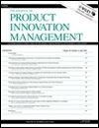
Agenda
Journal Overview
The Publishing Process
Getting Published
Discussion

Slide 3
Short History of JPIM
Founded in 1984 as an extension of the Product Development & Management Association
The first academic journal aimed directly at all aspects of new product development/innovation management
Different Disciplines: Cross-disciplinary in nature- marketing, strategy, design, management of technology, engineering, operations, etc.
Different Contexts: Large firms, SMEs, start-ups
Different Subjects: Consumers, Managers, Executives, B2B
All kinds of methodologies are welcome
International in nature
Academic publication of the PDMA and also the publication arm of EIASM’s International Product Development and Management conference
6 issues per year

Slide 4
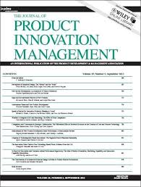
Mission
We seek to publish inquiries in the domain of innovation that ask consequential research questions and generate meaningful and credible answers through rigorously and ethically conducted
theoretical and empirical studies.

Slide 5
JPIM Reach & Impact
Submissions: 500-550/yr
Acceptance rate = 5-7%
Desk Rejection Rate ~60%
Global Reach – submissions balanced across Europe, US, Australasia
Rankings:
2016: 4/47 (Engineering Industrial); 20/140 (Business); 29/209 (Management)
Other rankings:
Top Tier (4) - Association of Business Schools, UK
“A*” ranking - ABDC (Australia Business Deans Council)
“A” ranking - VHB ranking, Germany
H-index = 126 (http://www.scimagojr.com)
2018
3-year impact factor = 3.78
5-year impact factor = 5.82
Notes:
2016: 4/47 (Engineering Industrial); 20/140 (Business); 29/209 (Management)
How is Journal Impact Factor Calculated?JIF=Citations in 2018 to items published in 2016 (241) +2017 (122)=363
Number of citable items in 2016 (54) + 2017 (42)96
2018 Journal Impact Factor=363=3.78196

Slide 6
Where do you think JPIM is most downloaded?

Slide 7
2018 Article Downloads by Country
Country | 2018
United Kingdom | 51102
Australia | 42606
Germany | 42056
Netherlands | 31765
China | 29903
United States | 26967
Italy | 10665
Switzerland | 9574
Denmark | 9271
Norway | 8399
Sweden | 8298
India | 7792
Turkey | 7349

Slide 8
JPIM Organization and Workflow
J

Slide 9
Editors-in-Chief
(Noble & Spanjol)
Associate Editors
(16)
Editorial Review Board
(93)
Founding and Advising Editor
(Hustad)

Slide 10
Associate Editor (AE) Team
USA
Non-USA
Name | Affiliation
Alexy, Oliver | Technical University of Munich, Germany
Atuahene-Gima, Kwaku | Nobel International Business School, Ghana
Bayus, Barry L. | University of North Carolina at Chapel Hill, USA
Bstieler, Ludwig A. | University of New Hampshire, USA
Cui, Anna | University of Illinois at Chicago, USA
Gemser, Gerda | RMIT University, Australia
Kim, Namwoon | Hong Kong Polytechnic University, Hong Kong
O´Connor, Gina | Rensselaer Polytechnic Institute, USA
Name | Affiliation
Ordanini, Andrea | Bocconi University, Italy
Rindfleisch, Aric | University of Illinois at Urbana-Champaign, USA
Rosa, José Antonio | Iowa State University, USA
Slotegraaf, Rebecca | Indiana University, USA
Spann, Martin | Ludwig-Maximilians-Universität (LMU), Germany
Srinivasan, Raji | University of Texas at Austin, USA
Tellis, Gerry | University of Southern California, USA
Wetzels, Martin | Maastricht University, Netherlands

Slide 11
JPIM Workflow
Author submits new work
EICs make first assessment
Reviewer selection and review
EIC assesses initial review
Promising manuscripts assigned to AE
R&R opportunity communicated to authors
REVISION…
Desk Rejection
Reject Decision
Review cycle(s)
continue until AE
has Accept or Reject
Recommendation for
EIC

Slide 12
How long do you think it takes to get an article accepted?

Slide 13
Speed (2018 data)
Submission to initial (DR v. Review) decision = 11 days
Submission to Acceptance = 440 days*
*down from 599 days in 2017

Slide 14
JPIM Activities and Initiatives
C

Slide 15
Some interesting things we do
Paper development workshops (PDWs)
Campus visits
Social media efforts
Recently revamped editorial structure and process
Topic-driven virtual (online only) issues
Bi-annual doctoral consortium
Next at the University of Illinois Urbana-Champaign, August 2019
Two organizational affiliations
Product Development & Management Association (formal)
Annual “Research Forum” conference (next one in Orlando, FL, November 2019)
European Institute for Advanced Studies in Management (less formal)
Innovation and Product Development Management Conference (IPDMC)

Slide 16
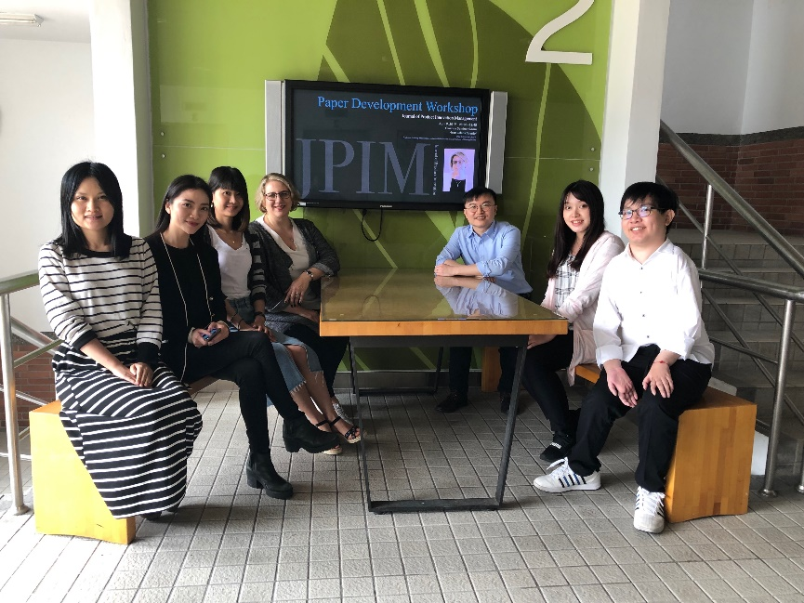
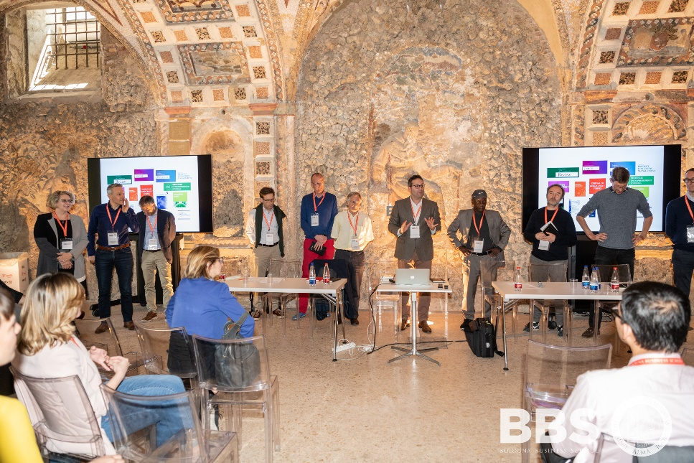
Paper Development Workshops
So far, we held three PDWs and participated in one joint PDW
LMU Munich PDW (April 2019, full day)
Led by C. Noble & J. Spanjol
8 postdocs / faculty from Germany, Italy, Switzerland, Netherlands, UK
Taiwan University (Taipei) PDW (April 2019, ½ day)
Led by J. Spanjol
5 doctoral students, 1 faculty
Xi’an Jiaotong University PDW (May 2019)
Led by C. Noble
30 doctoral students, 6 faculty
Bologna Business School PDW (May 2019, two days)
“The Future of Conducting and Publishing Research in Entrepreneurship, Innovation Management and Strategy”
Other journals represented: AMJ, AMR, SMJ, Org Sci, JBV, ETP, SEJ, and others
Participation by J. Spanjol
Ca. 30 early career scholars
We are open to universities hosting a PDW (typically one-day long) and opening up the call to scholars beyond their institution. Please email us.
Notes:
H-index = ¹The h-index is defined as: “A scientist has index h if h of his/her Np papers have at least h citations each, and the other (Np-h) papers have no more than h citations each” (Hirsch, 2005).

Slide 17
Other 2019 Editor Presentations
January-July 2019
AMA Winter – Austin (Noble)
BMW Doctoral Network – Munich (Spanjol)
University of Warwick (Noble)
University of Sussex (Noble)
Danish Technical University – Copenhagen (Spanjol)
Academy of Marketing Science Conference – Vancouver (“Siva”)
EMAC – Hamburg (Spanjol)
IPDMC – Leicester (Noble, Spanjol)
ISPIM – Florence (Spanjol)
R&D Management (Barczak)
DRUID – Copenhagen (Verganti)
AMS World Marketing Congress (Spanjol)
Planned
PDMA/JPIM UIUC Doctoral Consortium – Champaign IL (Spanjol, Noble)
AMA Summer – Chicago (Noble)
AoM – Boston (Spanjol)
and more…

Slide 18
What is (are) the purpose(es) of a “Special Issue”?

Slide 19
Upcoming Special Issues
The Human Side of Innovation Management
MATTHIAS WEISS (Ruhr-Universität Bochum), MARKUS BAER (Olin Business School, Washington University in St. Louis), MARTIN HOEGL (Ludwig-Maximilians-Univ. Munich)
Topics include:
Human factors in the front-end of innovation
Interpersonal relations and interaction among innovators
Leadership and Innovation
The role of setbacks and adversity for innovators
Organizing the innovator’s workplace in the next decade
Connecting with Academy of Management divisions (e.g., TIM, OB, MOC), Society of Industrial and Organizational Psychology, European Association of Work and Organizational Psychology, among others. Conference October 2020 at the University of Bochum.
Submission Deadline: May 31, 2020
Notes:
H-index = ¹The h-index is defined as: “A scientist has index h if h of his/her Np papers have at least h citations each, and the other (Np-h) papers have no more than h citations each” (Hirsch, 2005).

Slide 20
Upcoming Special Issues
Design Thinking and Innovation Management: Matches, Mismatches and Future Avenues
ROBERTO VERGANTI (Politecnico di Milano), CLAUDIO DELL’ERA (Politecnico di Milano), K. SCOTT SWAN (The College of William & Mary)
Topics include:
Innovation theories and design thinking
Measurement issues in design thinking
Human factors in design thinking
(and other topics)
A dedicated conference will be held in Williamsburg, Virginia and organized by the Mason School of Business, College of William & Mary, to bring together leading scholars and push design thinking research forward.
Submission Deadline: January 31, 2020
Notes:
H-index = ¹The h-index is defined as: “A scientist has index h if h of his/her Np papers have at least h citations each, and the other (Np-h) papers have no more than h citations each” (Hirsch, 2005).

Slide 21
How should we think about the interplay of academic research and practice?

Slide 22
Relevance and Rigor
Source: @AcademicsSay

Slide 23
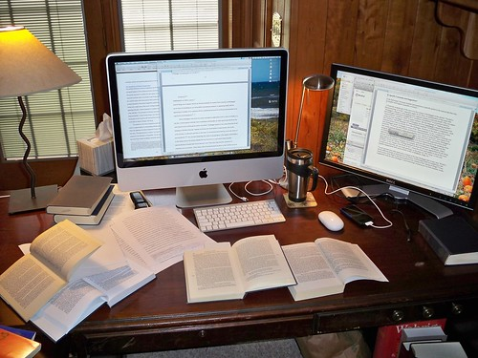
- Problems
Trends in practice
Experience
Corporate research
Data
$$$
Rigorous research
Broad insights
Advanced skills
More of a theoretical lens
Unbiased perspectives

Slide 24
Types of Articles
New category: JPIM Catalyst
(see full guidelines on JPIM website: https://onlinelibrary.wiley.com/journal/15405885 and editorial in July 2019 issue)
Aims of JPIM Catalyst Articles
As we think about alternate formats for conveying relevant insights to our audience, we are motivated by four goals: (1) connecting to our scholarly mission (such as spurring new research or reflecting on past publications), (2) providing a platform for impactful insights from those uniquely qualified to start or contribute to a conversation, (3) acknowledging that not all contributions need to exhibit the traditional methodological trappings nor even the length we are used to in typical journal articles, and (4) achieving faster speed or “time-to-market” for timely and important thinking. To these ends, we introduce Catalyst pieces as an alternative to the traditional original research published in JPIM, in the process also replacing the past “Perspective” and “From Experience” formats.
Notes:
H-index = ¹The h-index is defined as: “A scientist has index h if h of his/her Np papers have at least h citations each, and the other (Np-h) papers have no more than h citations each” (Hirsch, 2005).

Slide 25
Finding success publishing in JPIM
J

Slide 26
Getting Started
Research Idea
Interesting – not just to you; attract the reader
Important – significant, valuable
Relevant – to the audience and to today’s world (academic and practitioner)
Novel – adding something new; new phenomenon
Journal Considerations
Fit of research with journal
Quality of journal (what does your school/department value/require?)

Slide 27
Prior to Submission
Read submission guidelines
Read articles in the journal
Get a “friendly“
review
Consider copy editor services

Slide 28
During Submission
Transparency with Editors
* Be transparent with Editors; tell the truth about the paper
* Let Editors know if you have presented an earlier version of the paper at a conference (s)/based on thesis; used data in multiple papers; previous submissions
Committee on Publication Ethics (COPE)
* Become familiar with the guidelines of the Committee on Publication Ethics – COPE
www.publicationethics.org
Reviewer
Suggestions
* Suggest reviewers who can insightfully and objectively review your work

Slide 29
What are the major reasons for a desk rejection?

Slide 30
Avoiding a Desk Rejection
Does the paper lack fit (topic, positioning)?
Does the plagiarism check indicate a high similarity rating?
Is the contribution to theory (and practice) unclear?
Are there red flags regarding rigor? (e.g., small student sample when claiming to study managers)
Is the paper poorly written?

Slide 31
Getting through the Review Process
Convince the reader!
What is the research question and why is it important?
Why is the contribution important enough?
How is this study going beyond what we already know?
What are the implications and what will change? (discussion section)
Explain better!
What was exactly done in empirical study?
Why are the methodological choices appropriate?
What were the results? (figures, tables, graphs)
What wasn’t so good? (limitations and future research section)
Be more clear!
Why are you talking about this?
What do you mean?
Effective use of Appendices, figures, tables
On REVISIONS:
- Pay attention to all the reviewer comments
- Respond to each comment (do not ignore)
- Responses explain changes, do not simply repeat revised manuscript chunks
- Consider engaging a copy editor

Slide 32
More about JPIM
Wiley Information Page: https://onlinelibrary.wiley.com/journal/15405885
Wiley Manuscript Central: https://mc.manuscriptcentral.com/jpim
Twitter: @JournalPIM
LinkedIn: https://www.linkedin.com/groups/6943012/

Slide 33
Engaging with the JPIM community

Slide 34
How You Can Engage with the JPIM Community
Send us your great research!
Read JPIM articles, and cite them!
Attend the JPIM Research Forum (US, November) and/or the IPDMC Conference (Europe, June)
Become a JPIM reviewer (sign up on journal website/ScholarOne)
Submit a Special Issue proposal (see guidelines on journal website)
Host a Paper Development Workshop (email editors)
Sponsor and host the JPIM Doctoral Consortium (email editors)

Slide 35
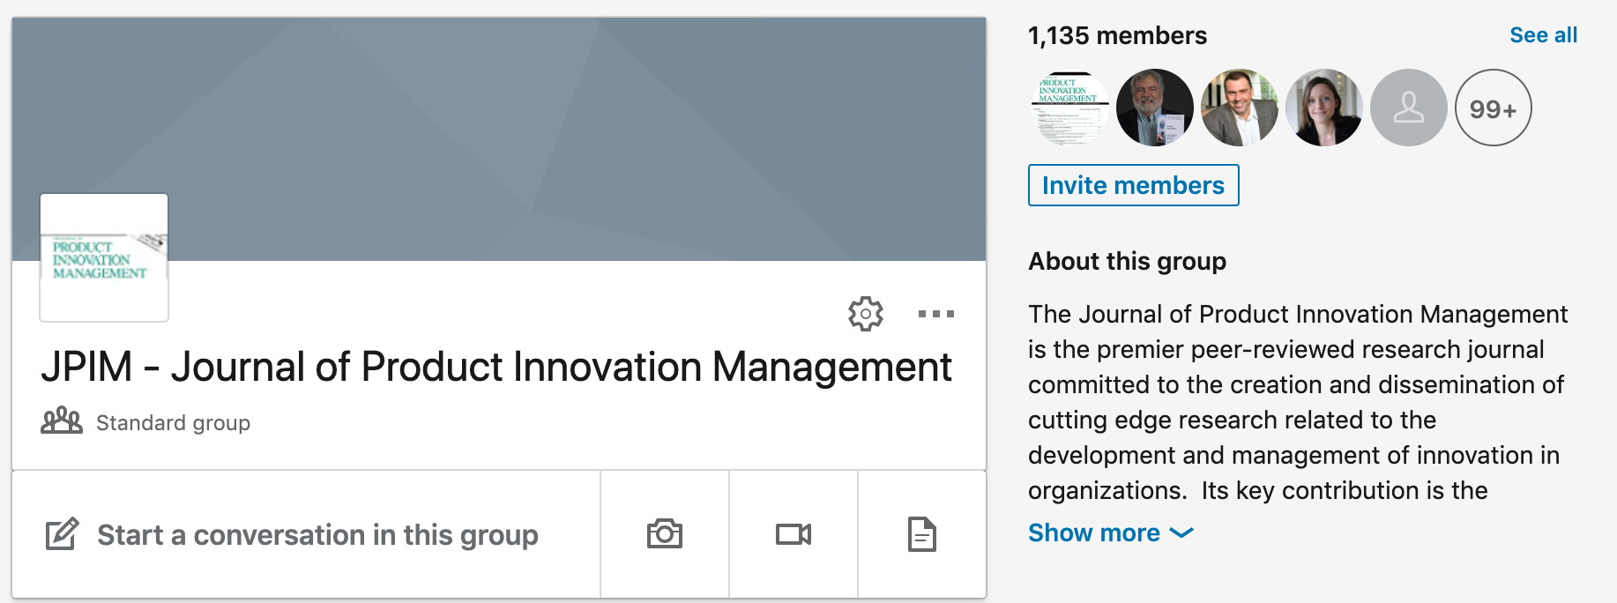
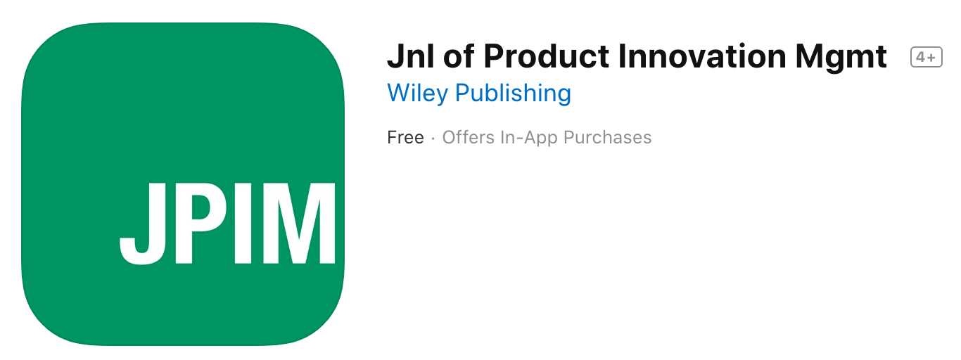
Social Media
Please follow us / contribute:
Twitter (@JournalPIM)
tweet, retweet, ask your kids!
LinkedIn (Request to join the JPIM group)
membership 2,000 → 3,000 in last 4 months
App
Wiley Information Page: https://onlinelibrary.wiley.com/journal/15405885
Wiley Manuscript Central: https://mc.manuscriptcentral.com/jpim

Slide 36
Open Discussion
Questions?
Comments?
Suggestions?
THANK YOU!

